Slide 1
CST 150 Project 3: Full-Stack Club Website
Prepared By:
Lijan Baral Cameron Brotherton Hector Marquez

Slide 2
Project Info with Ideation of website
Responsive full-stack website
Theme for the club events and merchandise-selling platform
Objective of giving a simple, responsive, and secure shopping experience along with insights into sales summary.
Main audience focus on Shoppers who are club members and want to find products in a single place.
Also on the backend side: admin for getting information about sales.

Slide 3
Showcase of Shopper Experience
Browse and explore the website
Select from different club products and merch
Add them to the cart and edit through the choice of quantity and quality
Place the order with your personal information
Check out and complete the sale
Demo for this will be shown:

Slide 4
Showcase for the admin experience
Admin login using their own passwords and credentials
System authenticates the input and validates it for login.
After successful login, view the sales insights in the dashboard
Keeps a record of completed sales with the user data
Demo for this will be shown

Slide 5
Technical Implementation
Front end
Backend
Uses HTML for structure
Uses CSS for styling
Uses JavaScript for interaction
Made a responsive design for user experience according to device screens.
Used an API request for backend connection.
Used Python Flask for the connection to the frontend.
Used a REST API to connect the database to the website
Performed different validations and authentication for security
Focused on CRUD operations
Created a SQL database for storing product and user information

Slide 6
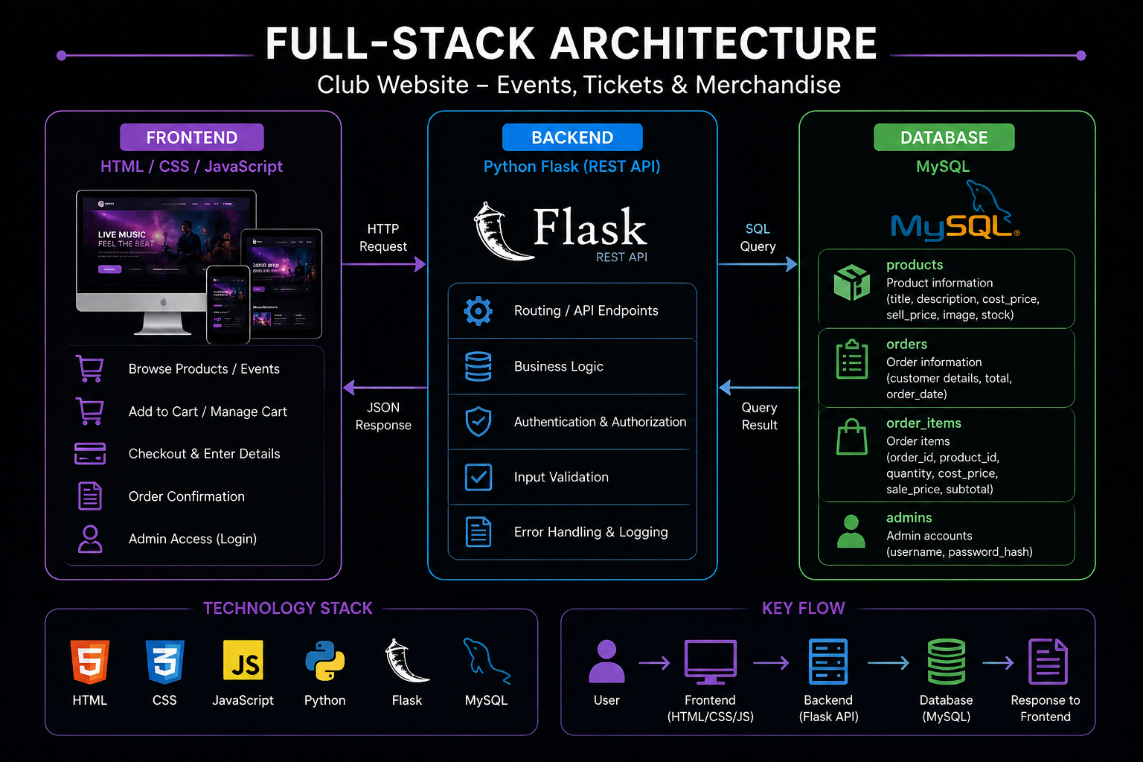
Workflow and architecture:
Frontend → Flask API → MySQL → Flask API → Frontend

Slide 7
Security, Usability & Responsive Design
Security
Usability
Parameterized SQL queries
Input validation
Backend validation
Admin authentication
Password hashing
Secure database configuration
Error handling
Responsive layout to fit the content according to the device
The website has clear navigation and structure
Good color contrast and text visibility

Slide 8
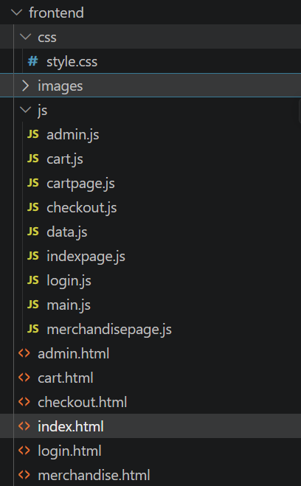
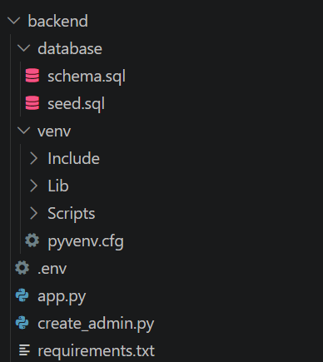
Folder structure for the project

Slide 9
Design & Colour Palette
Nightwave — Digital Club Store
Signal Pink
Primary accent / CTAs
#FF2E88
Draws the eye to Add to Cart and prices — the one colour that must never blend in.
Why this direction
Late-night, not corporate.
Afterhours Purple
Gradient partner
The products are DJ mixes, sample packs and event passes — a light retail theme would undersell what's being sold. A near-black base makes every drop feel like it's meant to be browsed after dark.
#7C3AED
Pairs with pink across product art, echoing club lighting rigs without needing real photos.
One accent, used with intent.
Pink is reserved for actions and prices only. If every element competed for attention, nothing would stand out on a dark page — restraint keeps the CTA legible at a glance.
Strobe Blue
Secondary accent
#38BDF8
Used sparingly — live status dots, category tags — so it reads as a signal, not decoration.
Type carries the club identity.
A bold condensed display face for headings echoes flyer and rave-poster typography. A monospace face marks prices and admin data, tying back to the "gear read-out" feel of DJ equipment.
Neon Cyan
Data highlight
#22D3EE
Reserved for small live-state cues like "Now Dropping", keeping it rare and meaningful.
Contrast built in from the start.
Every colour pairing was checked against the dark surface first, not white — light text and saturated accents both hold WCAG-safe contrast on #0A0A12 without any extra overlays.
Background & Text
Base BG
Surface
Card
Text

Slide 10
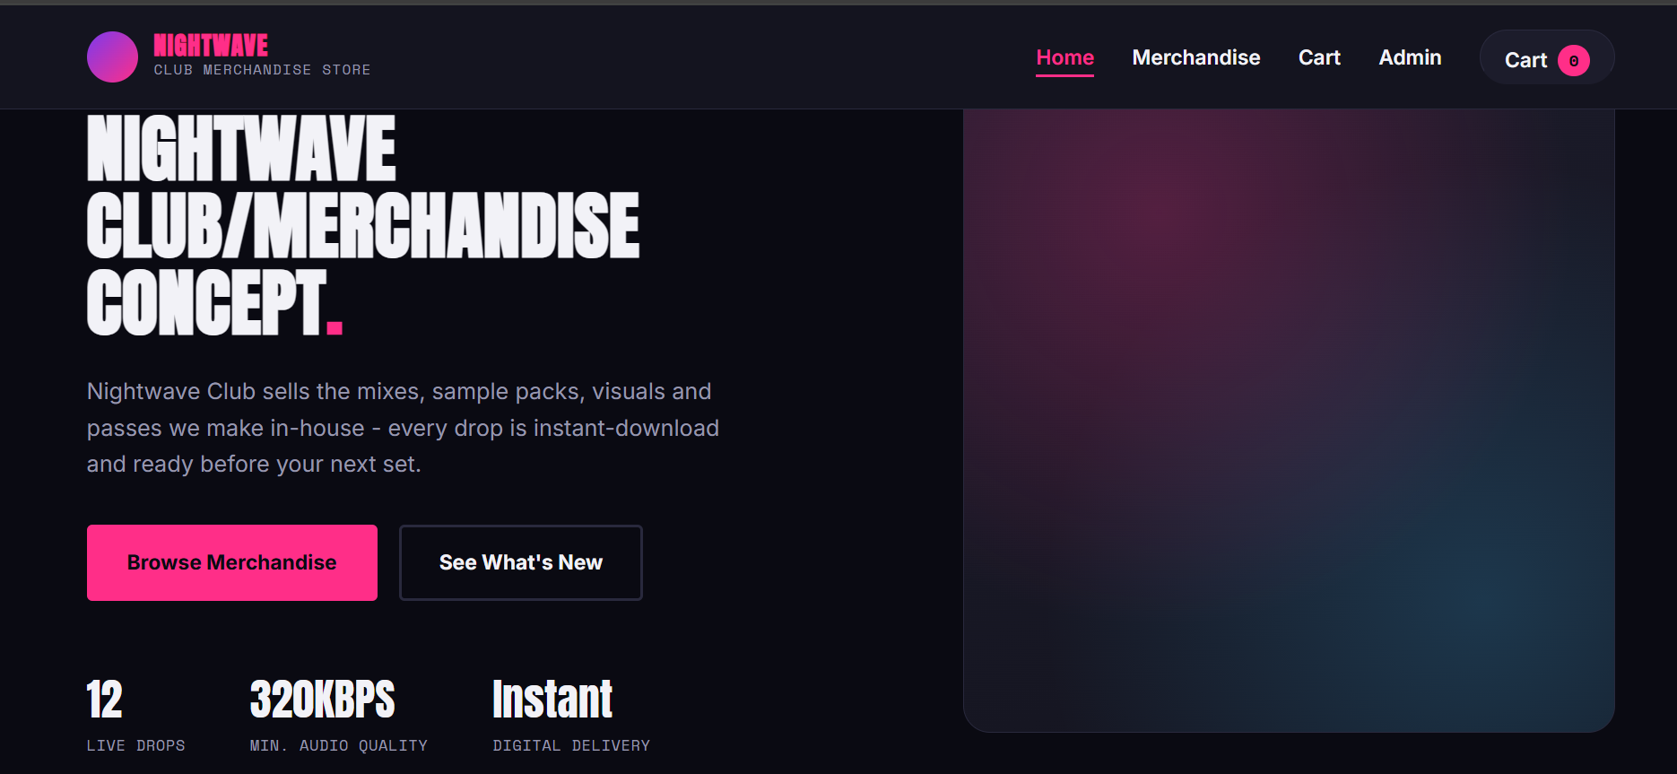
Website showcase:

Slide 11
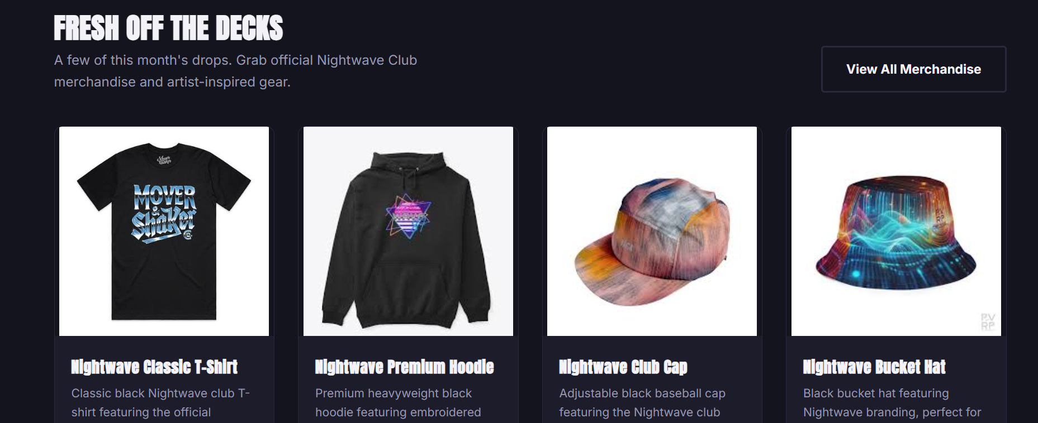

Slide 12
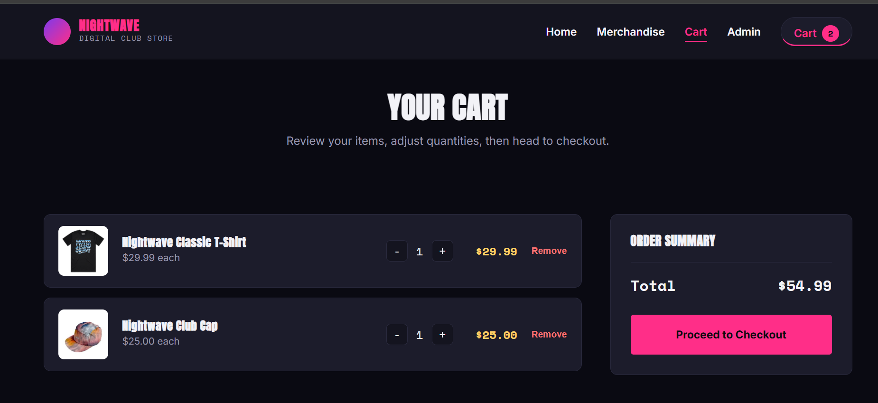

Slide 13
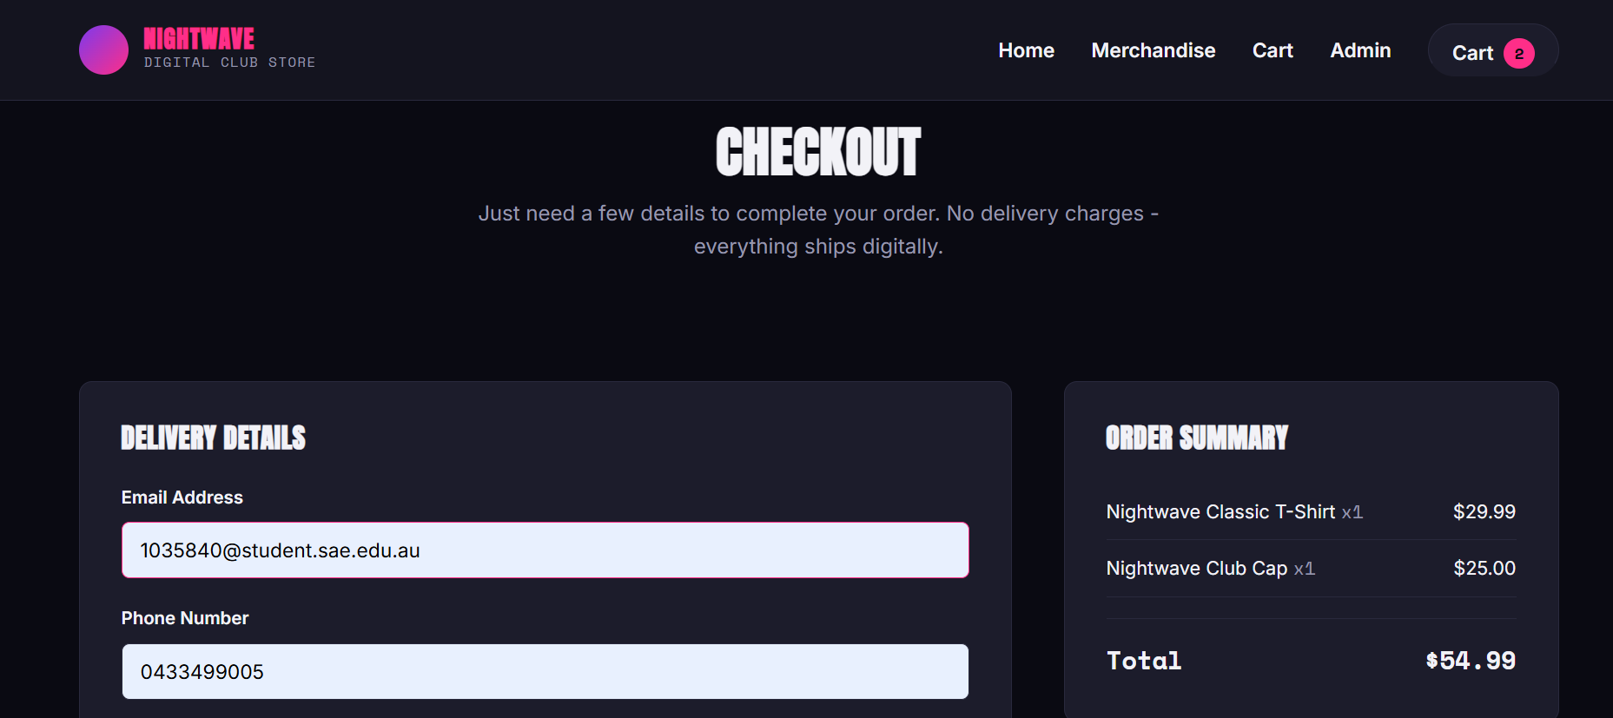

Slide 14
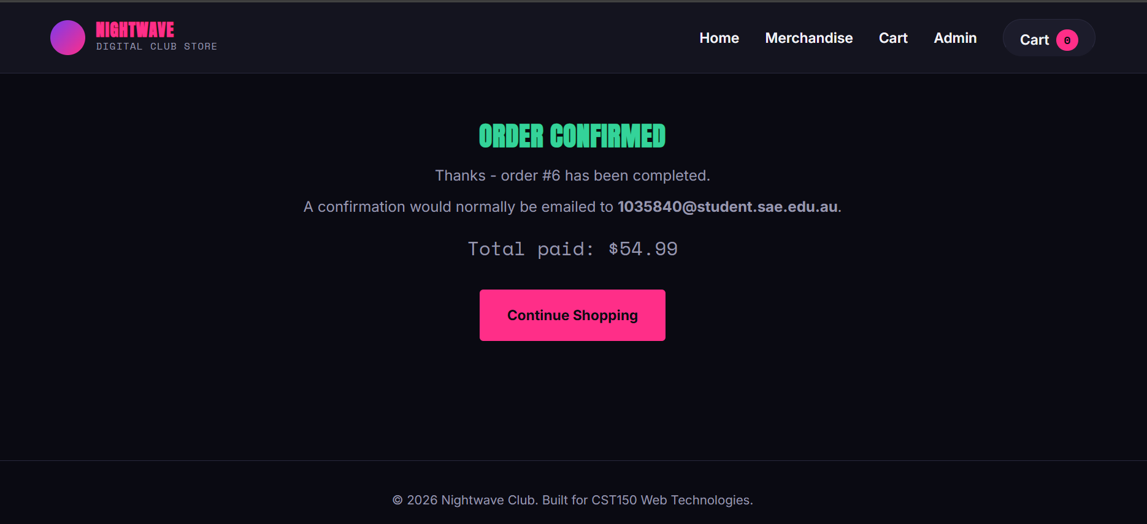

Slide 15
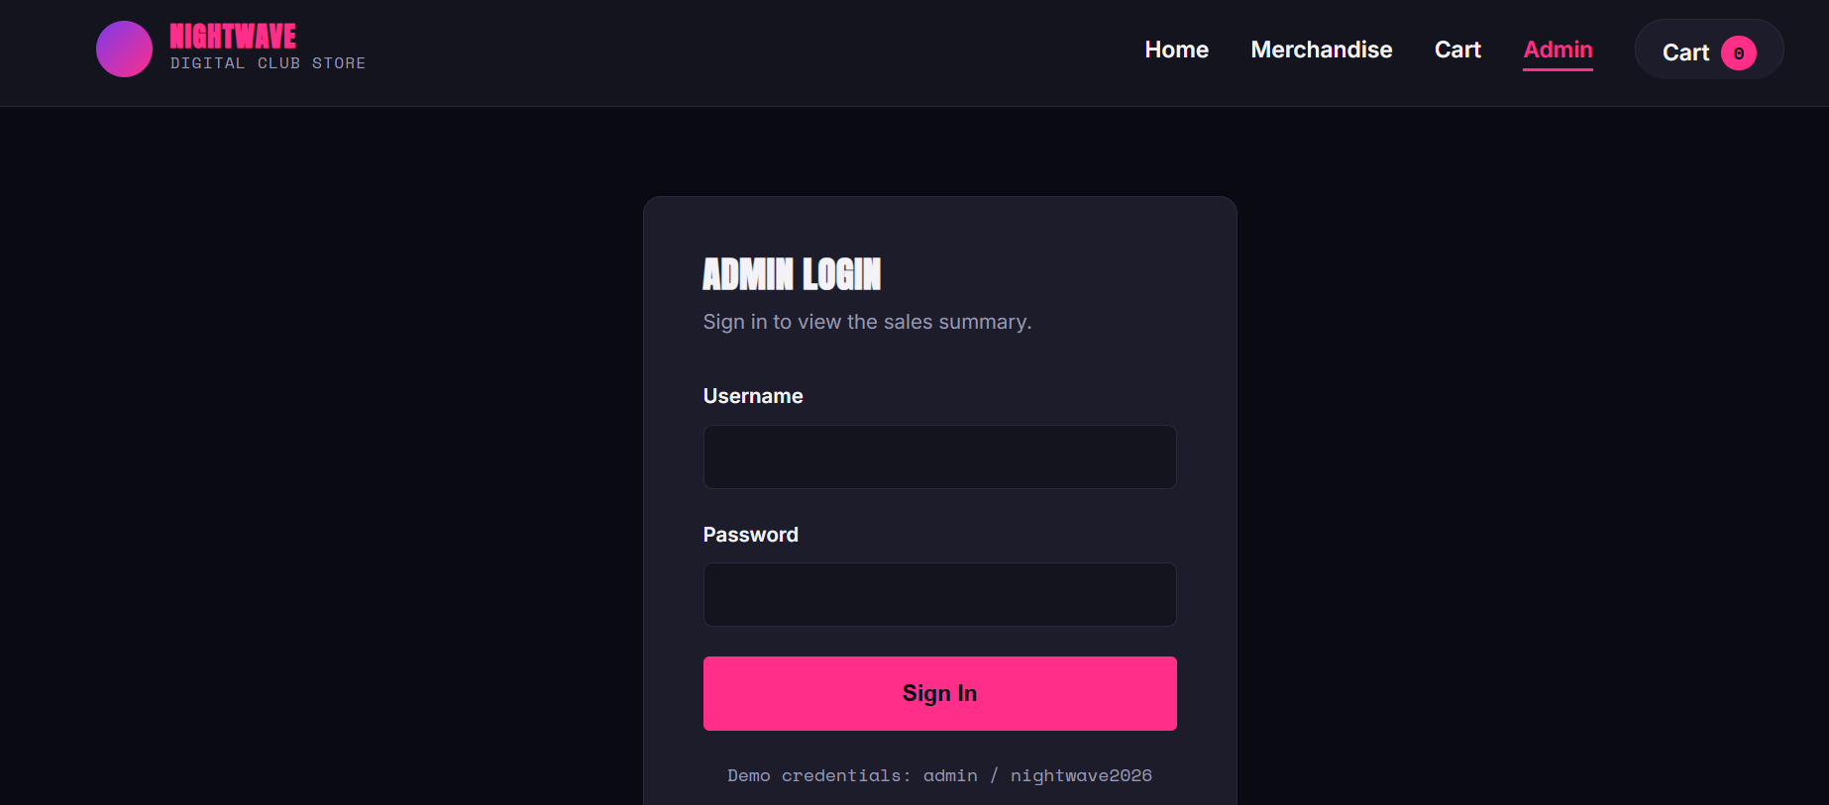

Slide 16
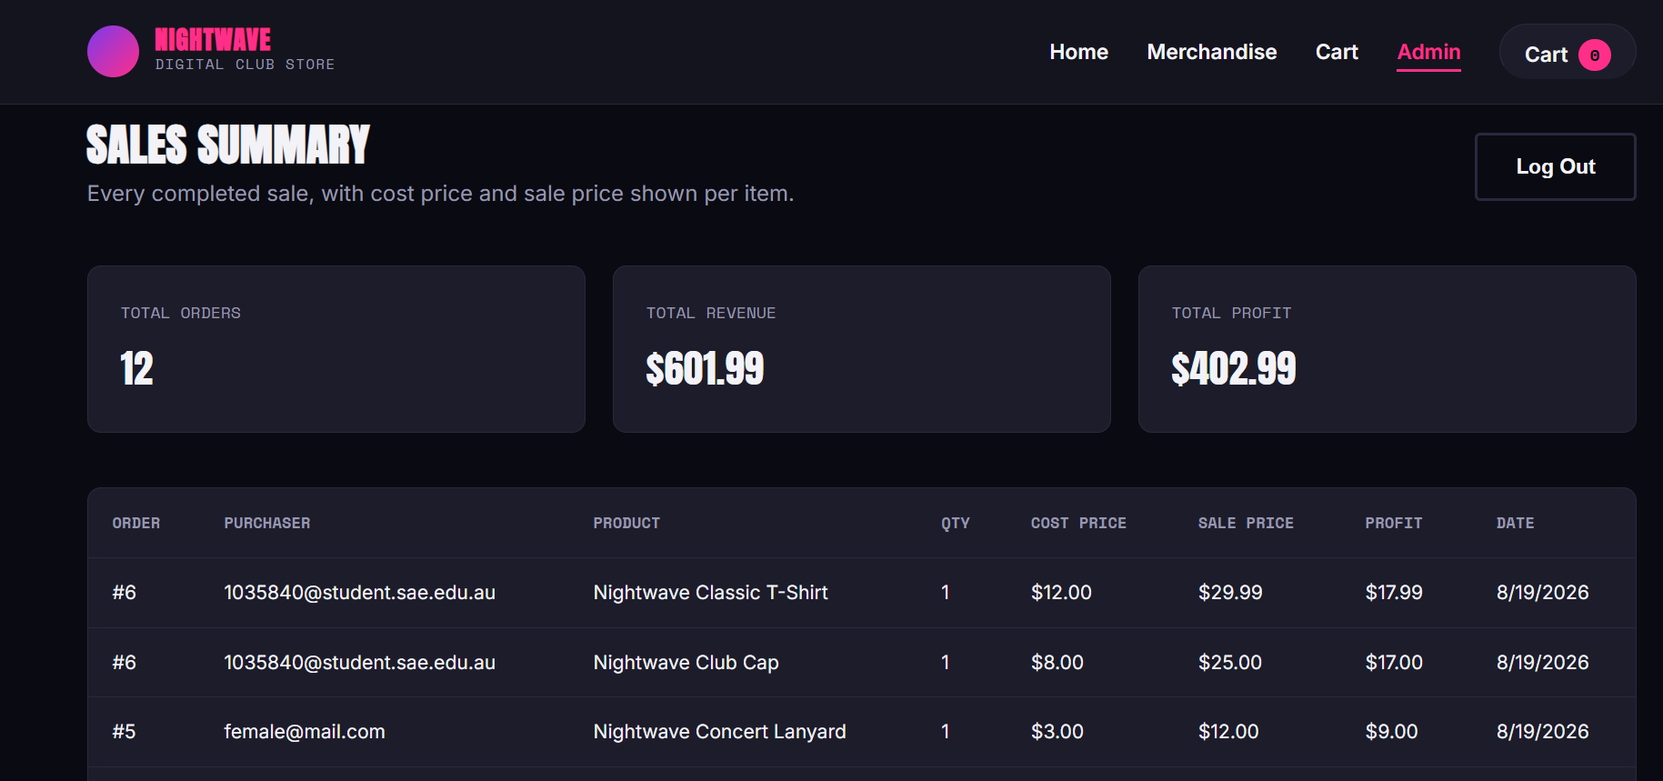

Slide 17
Team Contribution:
Team Members | Primary Contribution | Key Works
Lijan Baral | Backend with the final integration of the full-stack website | Worked on the backend folder of making a Python file and making the connection to the frontend and database. Taking care of security and prevent from SQL injections
Cameron Brotherton | Frontend and making UI for website | Created the frontend folder responsible for making the website design and interactivity with JavaScript
Hector Marquez | Ideation and database creation | Worked on the club's website theme to enhance branding and sell products. Created a database for products and other part of the website
In collaboration,
we did the testing and the PowerPoint slide for the presentation

Slide 18
Conclusion:
Our Club Website successfully combines a responsive frontend, Flask backend, and MySQL database into one full-stack shopping platform.
What we achieved
🎵 Event & product discovery — users can browse available club products/events.
🛒 Complete shopping transaction — shoppers can add, update, and remove items from their cart and complete checkout.
💳 Customer information — email, phone number, and suburb are collected during checkout.
🔐 Admin functionality — administrators can securely access completed sales.
📊 Sales information — admins can identify purchasers and view product cost and sale prices.
🔒 Security — input validation, parameterized SQL queries and authentication help protect the application.
📱 Responsive design — the website is designed for desktop, tablet and mobile users.

Slide 19


